Slide 1

Online Real Estate Marketing Services
Team Members
Shirisha Chintalapudi

Slide 2
Shirisha(MBA)
I have done my MBA in Finance and Marketing domains, also completed Bachelor’s degree with statistics, This Data Analytics course covers all aspects of my education. I would prefer to work as a finance and marketing analyst because it’s in line with my skills and interests. In addition, I have seen that the companies who hire for this role work in industries that are booming and can therefore provide good career growth.

Slide 3
Agenda
Objective of the Project
Data Collection
Raw Data
Data Cleaning
Data Visualization
Univariate Analysis
Bivariate Analysis
Multivarite Analysis
Conclusion

Slide 4
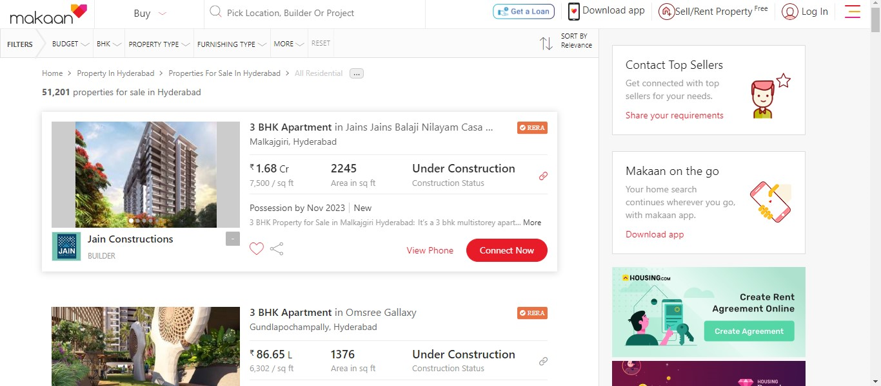
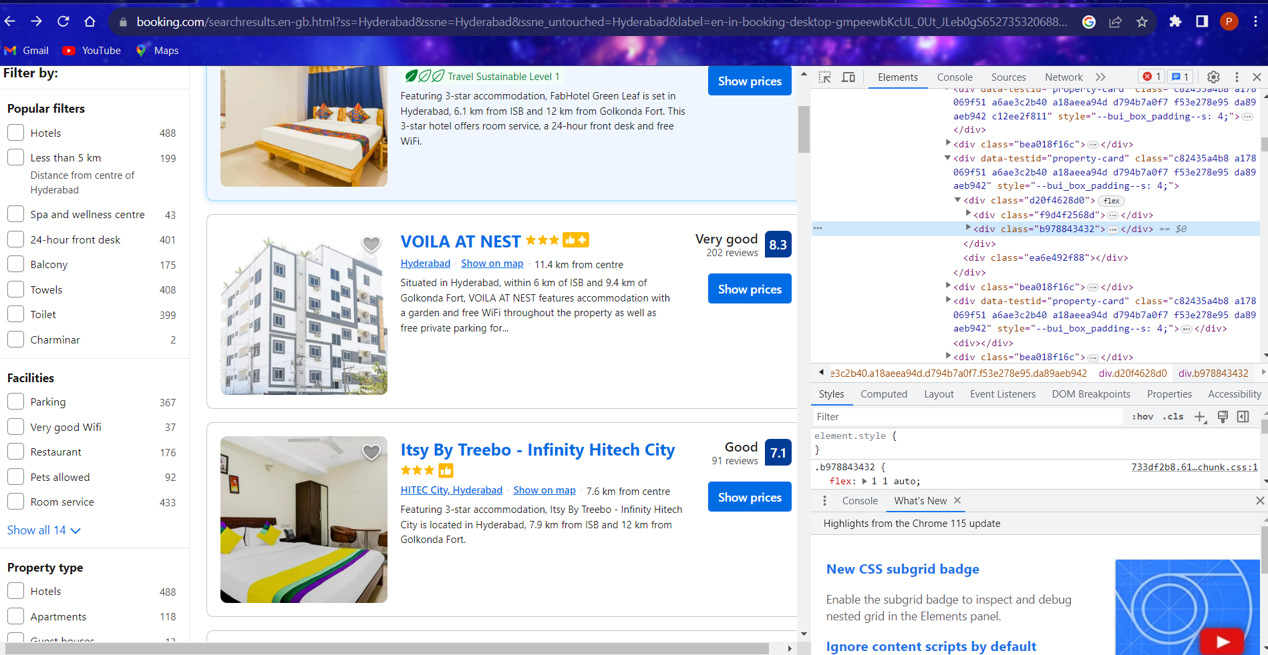
Objective: Makaan.com provides term and condition to use the services. Find term and condition for property in India at real estate website.
URL :https://www.makaan.com/hyderabad-residential-property/buy-property-in-hyderabad-city?_=1699893373150
AIM: To buy, procure, receive, rent, rent out, hire-purchase, hold ownership, own, improve, use and manage all types of assets and real estates as well as the profit of such assets, find the affordable prices for customers in required locations, on what kind of projects we invest the amount

Slide 5
Data Collection
For real time analysis data is scrapped from Booking.com website
Selecting required features from website
Save it to the .csv file
Scrap the data using Beautiful Soup library
Download URL data
Extract the features

Slide 6
Importance of EDA
Improve understanding of variables by extracting averages, mean, minimum, and maximum values, etc.
Discover errors, outliers, and missing values in the data.
Identify patterns by visualizing data in graphs such as bar graphs, scatter plots, heatmaps and histograms.

Slide 7
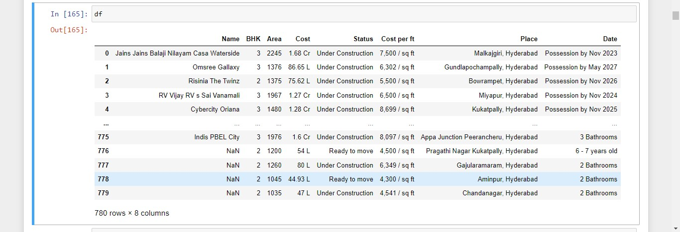
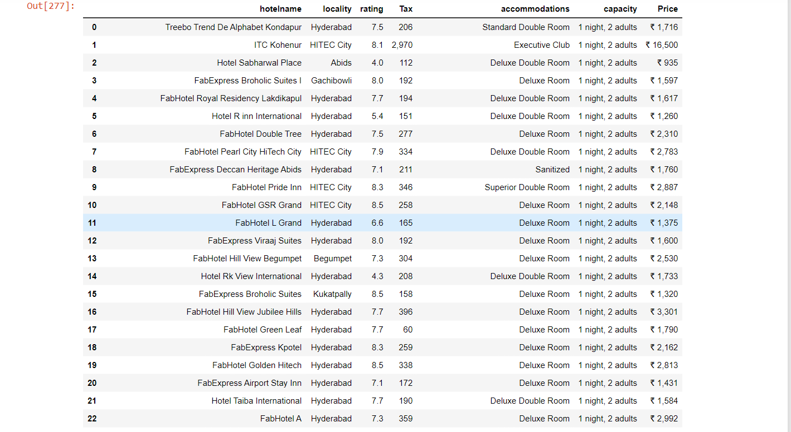
Raw Data

Slide 8
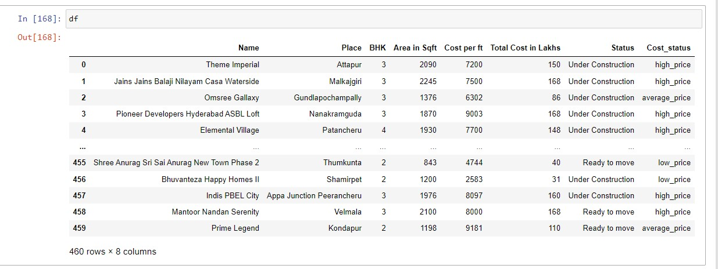
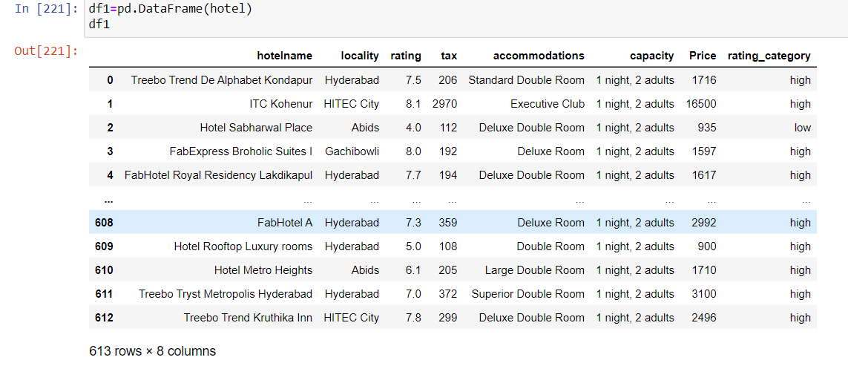
Data Cleaning
Inside the columns the special characters, so used regex to remove to clean the text also duplicates and null values are removed, deleted un necessary information, modified data types for required columns.
After cleaning data and applying some important codes , Numerical and Categorical data is ready for Visualization

Slide 9
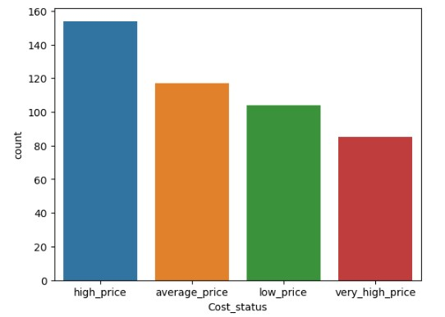
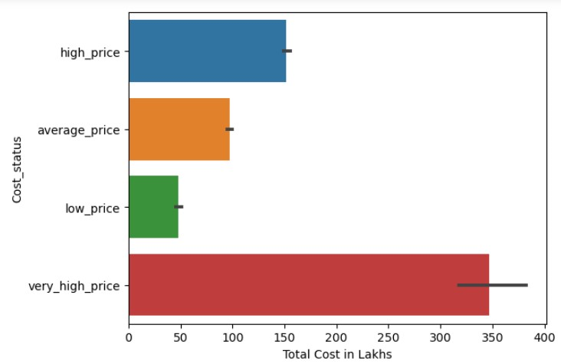
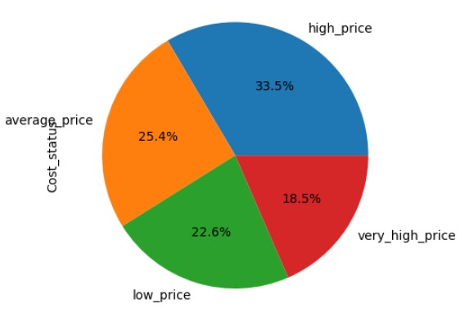
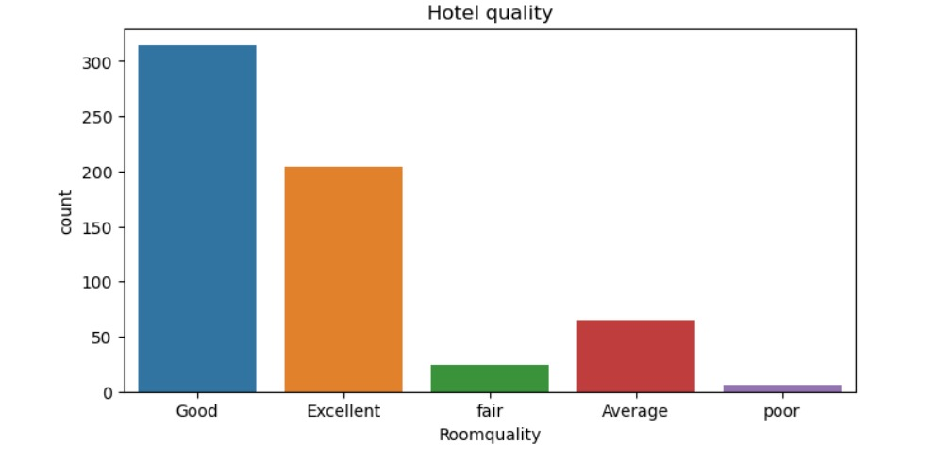
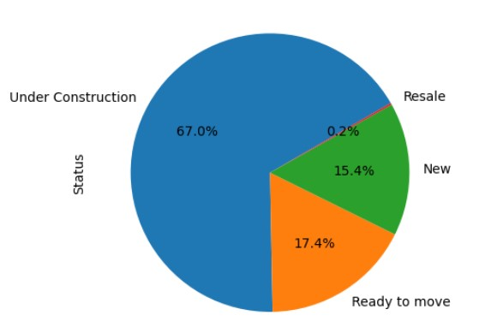
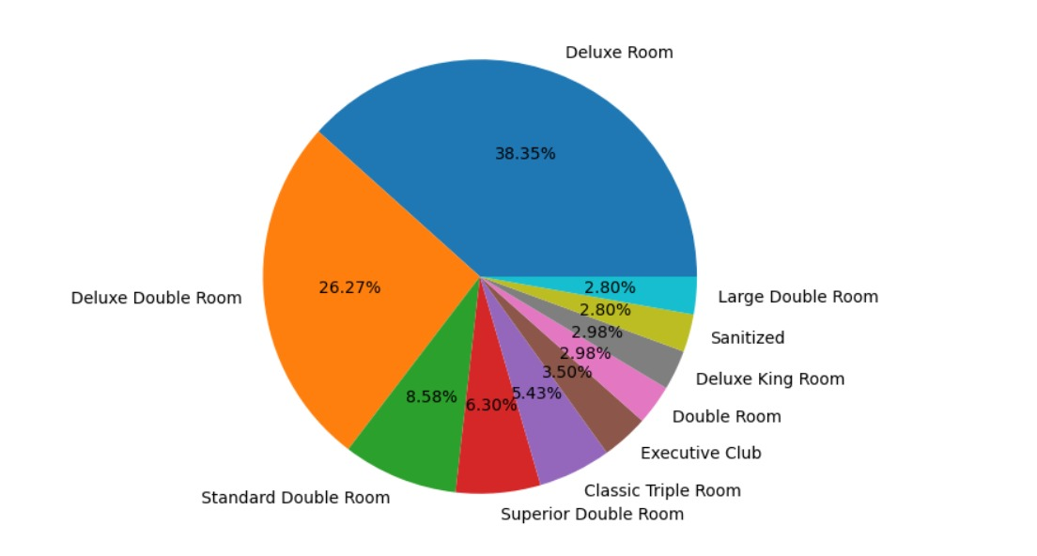
Data Visualization
Uni-variant Analysis
Accommodation’s
From the pie chart, to know about the percentages of different stages in status .
From count plot we can know about the count of cost status for different stages of prices.

Slide 10
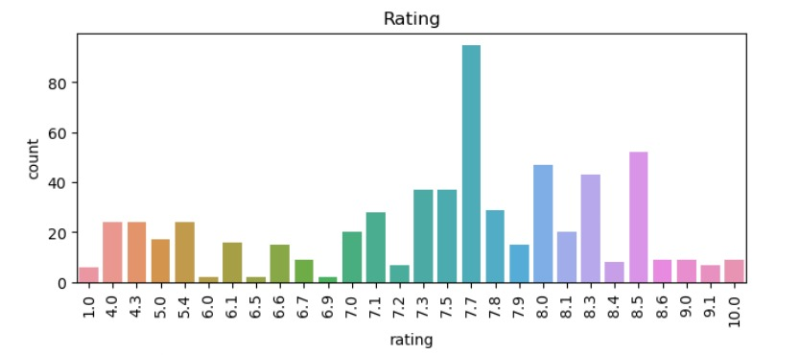
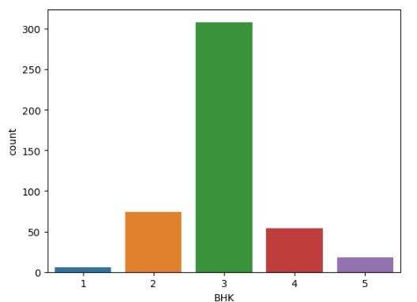
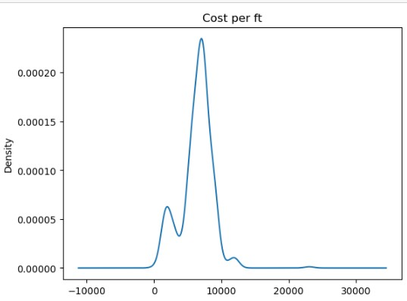
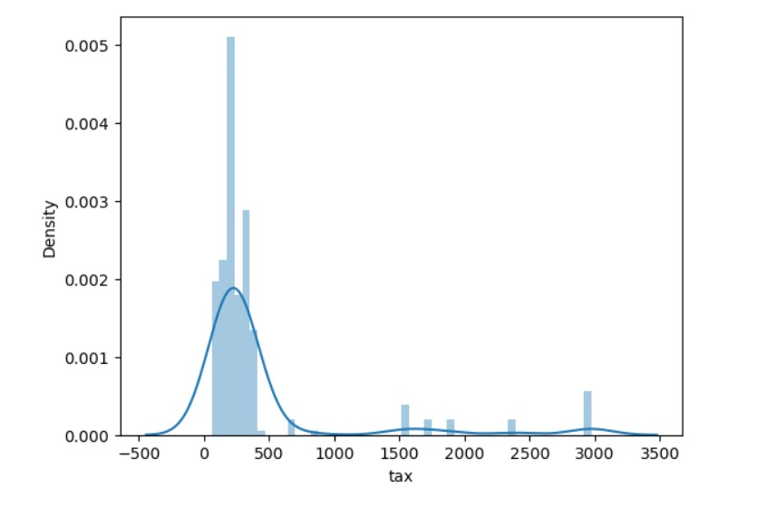
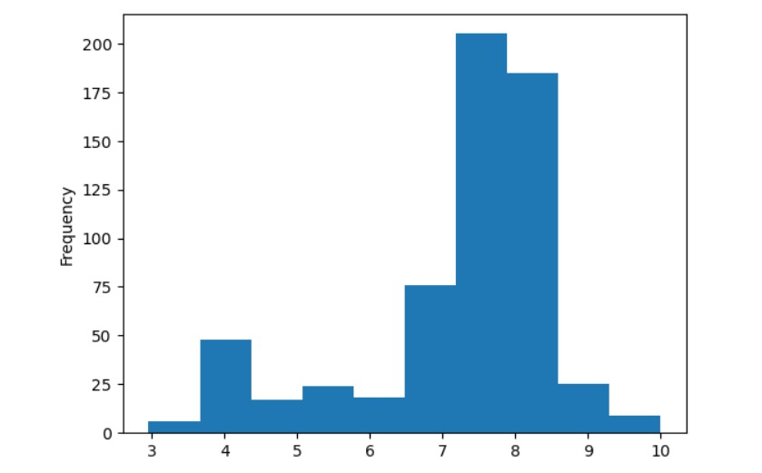
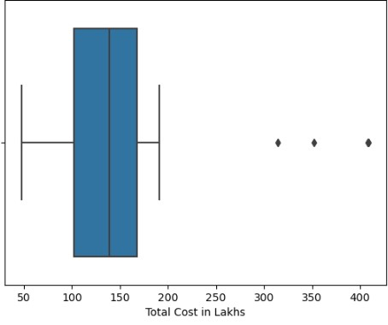
Univariate data visualizations:
First graph represents the maximum cost per feet.
From the second graph we know about the BHK count in different cities
From the third graph that we conclude that total cost of properties in lakhs.

Slide 11
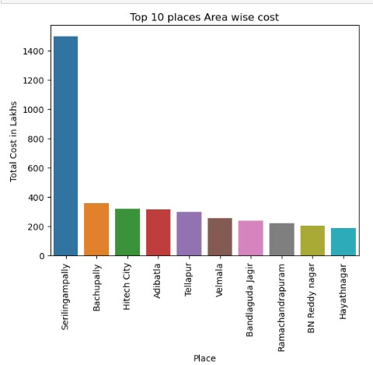
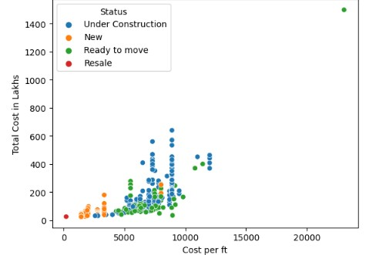
Bivariate Data Visualizations:
First graph represents the cost per feet for different stages of construction, cost is more is on under construction projects and cost is less is on new and ready to move projects.
Second graph represents the area wise total cost, it is showing clearly in serilingampally cost is very high and in sadashivpet cost is very less.

Slide 12
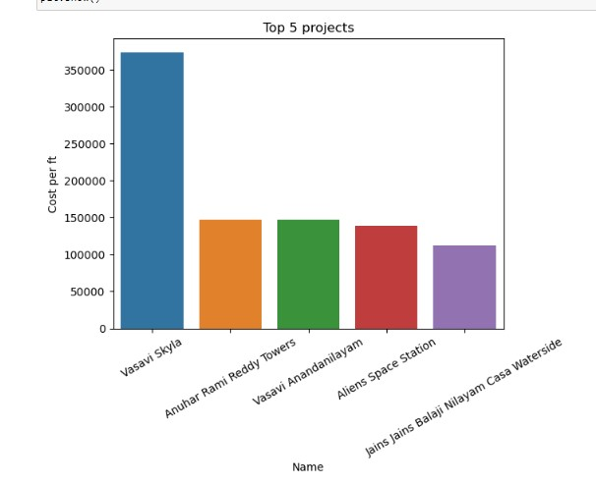
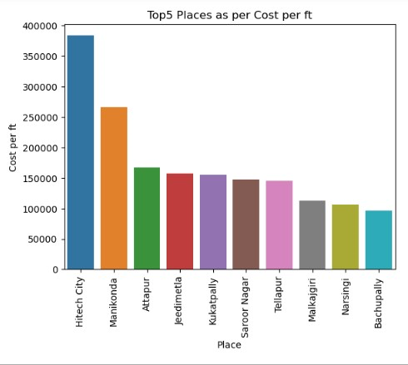
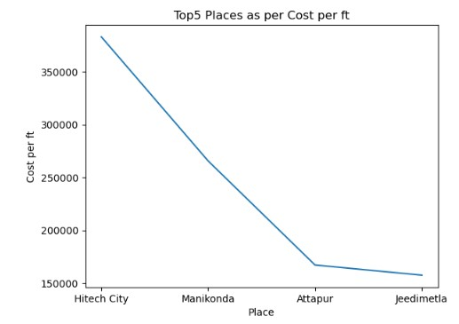
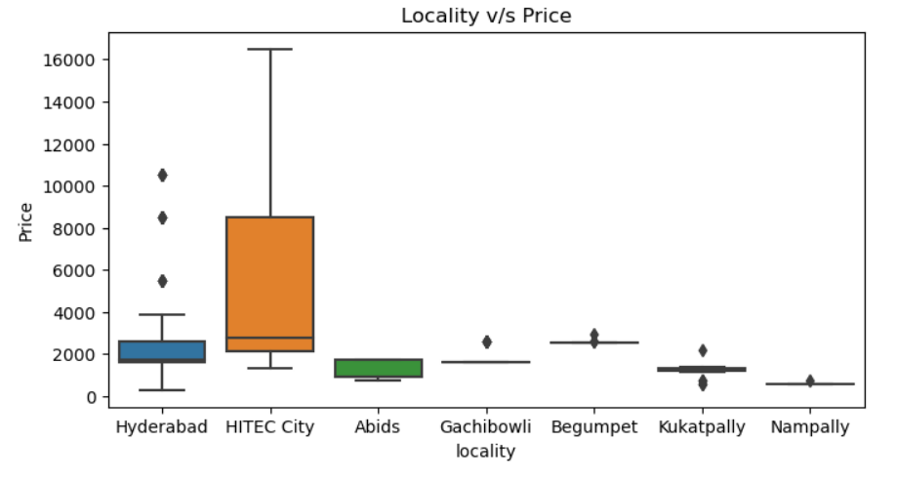
Below line graph represents the top 10 places as per cost per feet, it is showing falling down of price from manikonda to Attapur then price slowly reducing
From the above graph we can show the top 5 projects as per feet cost

Slide 13
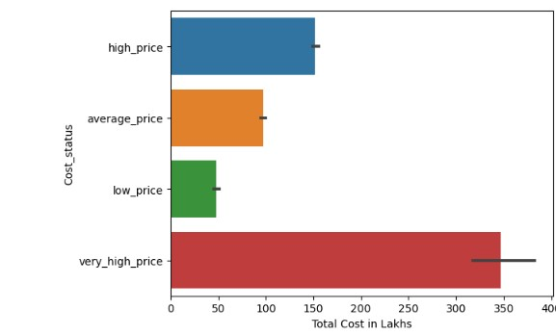
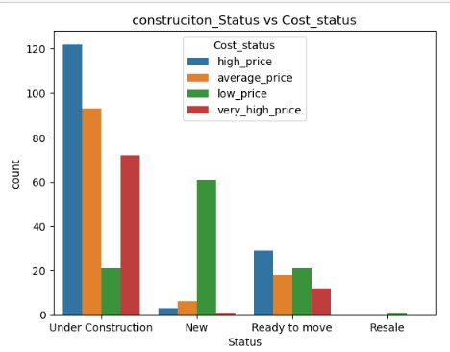
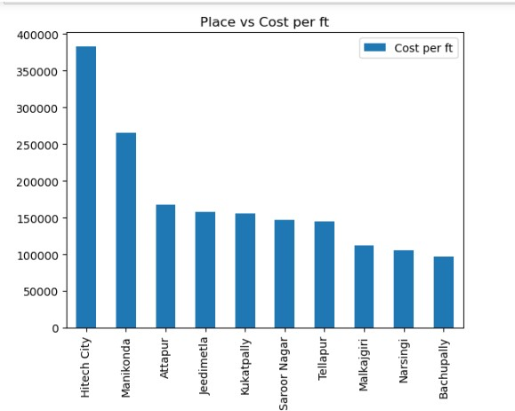
Below graph is visualization of top 10 places as per cost per feet, we can conclude that hi-tech city having more cost per feet
Above graph represents what is the cost status of all kinds of construction stages, we conclude that for under construction stage prices are high.

Slide 14
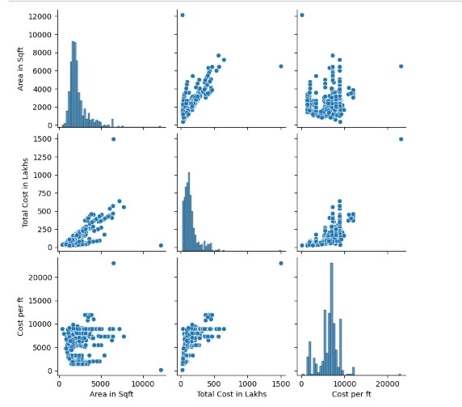
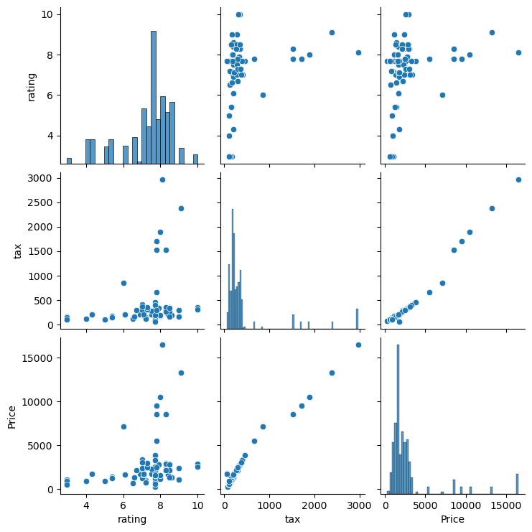
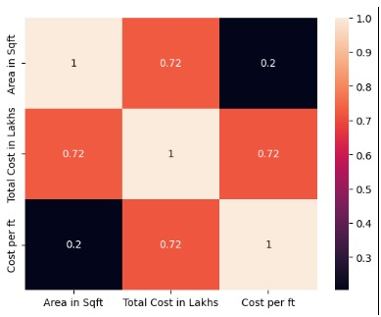
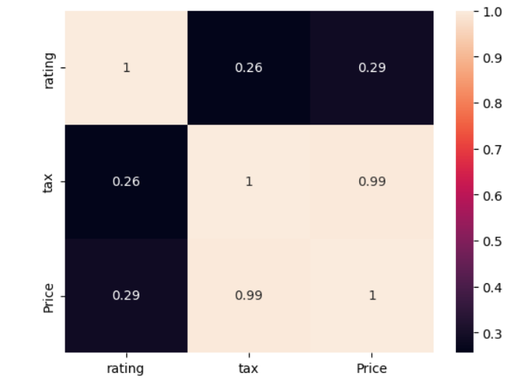
multivariate Analysis:
By using heatmap we can find the correlation between the columns.
categorical to categorical
Its shows pairwise relationship for all the numerical columns in a dataset

Slide 15
Conclusion
We can analyze the top most demand cities in Hyderabad for purchase or selling of properties, we came to know the high and low feet cost in different places, at Serilingam pally we have highest area wise sales and Hi-tech city is having more cost per feet compared with other cities, also price changes occurred in different places.
We can observe that prices are very high for under constructing stages and average prices on newly constructed stage.
So customers can invest on newly constructing projects.

Slide 16

THANK YOU

